Slide 1
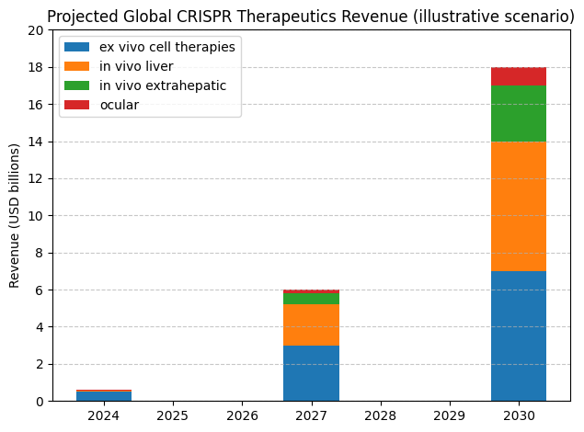
Market Outlook: CRISPR Therapeutics
Progressive approvals in hematology and liver indications
Manufacturing scale‑up reduces COGS and expands access
Extrahepatic delivery breakthroughs by late decade
Pricing pressure partially offset by outcomes‑based contracts
Notes: For planning discussion only; directional and non‑binding; not investment advice

